Slide 1

Welcome to Python
Introduction and Installation

Slide 2

What is Python?
Python is a high-level, general-purpose programming language. Python supports modules and packages, which encourages program modularity and code reuse.
Notes:
Note to self - make shorter / no big words

Slide 3

What is Jupyter Lab / Jupyter Notebook?
Jupyter Lab / Jupyter Notebook is a web-based interactive development environment for notebooks, code, and data. Its flexible interface allows users to configure and arrange workflows in data science, scientific computing, computational journalism, and machine learning.

Slide 4

What is Anaconda?
What is Anaconda?
Anaconda is a distribution for the Python programming language for scientific computing (data science, machine learning applications etc.), that aims to simplify package management and deployment. The distribution includes data-science packages suitable for Windows, macOS and Linux.
Download Python through Anaconda HERE
Please be sure to download the correct version depending on your computer’s operating system (Windows, MacOS, Linux)
Notes:
If for some reason you cannot download and install Anaconda. You can use the browser based lite version HERE. However this presentation will not cover how to navigate through the lite version.

Slide 5
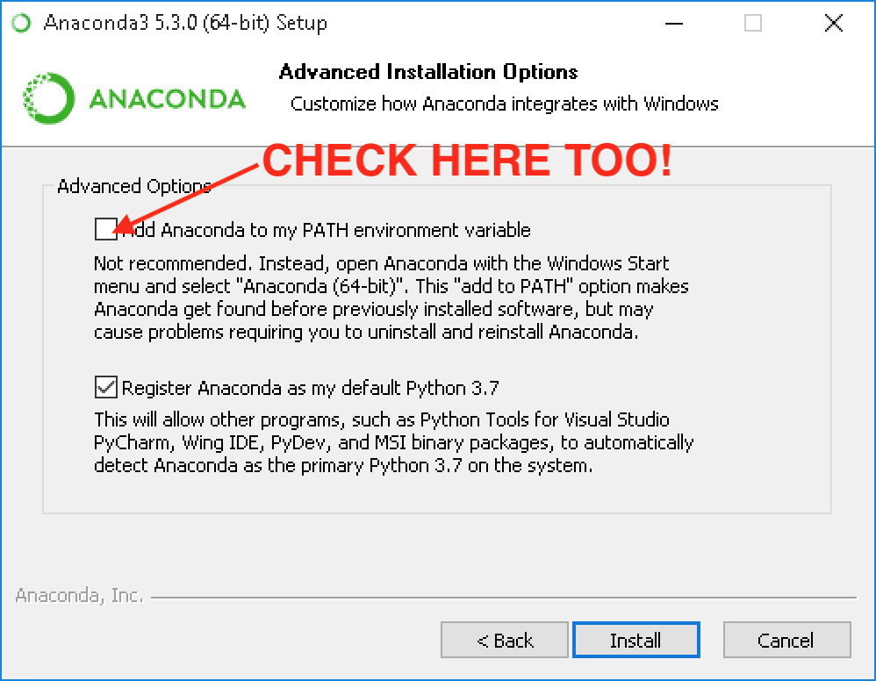
Installing Anaconda
Install Anaconda onto your computer. During the installation phase you will come across the image seen on the right.
Be sure to click “Add Anaconda to my PATH environment variable if you are using a Windows based operating system.

Slide 6
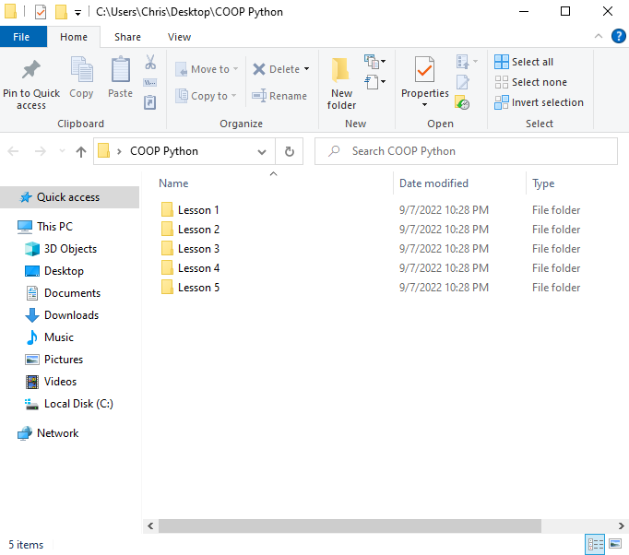
Folder Creation
Create a folder called COOP Python and place it on your Desktop.
Create 5 separate empty folders called: “Lesson 1” through “Lesson 5”

Slide 7
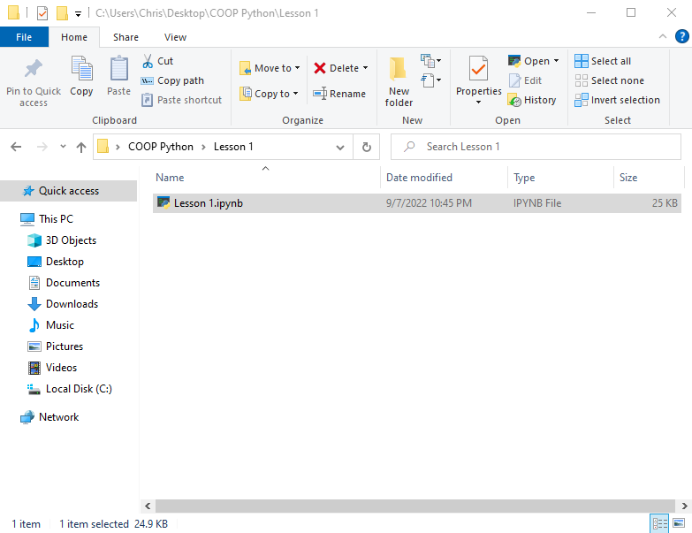
Download and Place Files
Download the Python content for lesson 1 provides by your COOP Captains or Google Classrooms. For this particular lesson you should be only 1 file to download named “Lesson 1.ipynb” and place “Lesson 1.ipynb” into the newly created folder named “Lesson 1” that you just created less than 2 minutes ago.

Slide 8
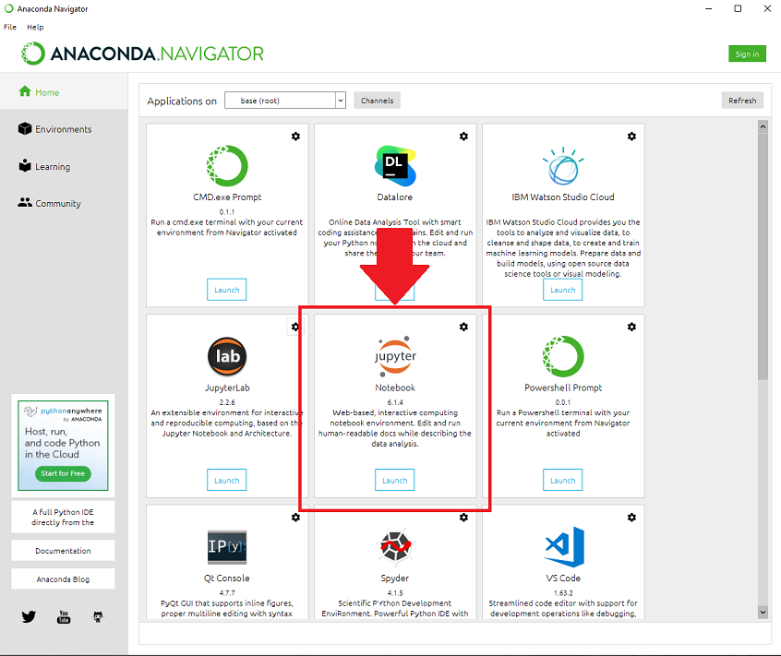
Launch Python
Launch Anaconda Navigator.
Click on Jupyter Notebook.

Slide 9
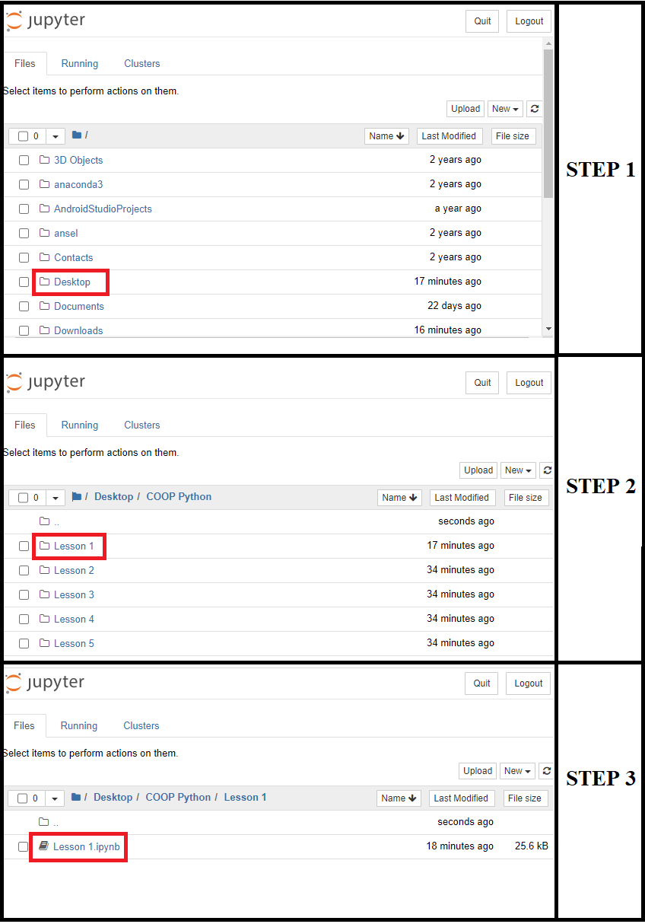
Opening a Python Notebook File
Navigate to your newly created “COOP Python” folder.
Click on “Lesson 1” folder.
Click on the “Lesson 1.ipynb” file and bam! The python notebook you downloaded from Google Classrooms should now be open.

Slide 10
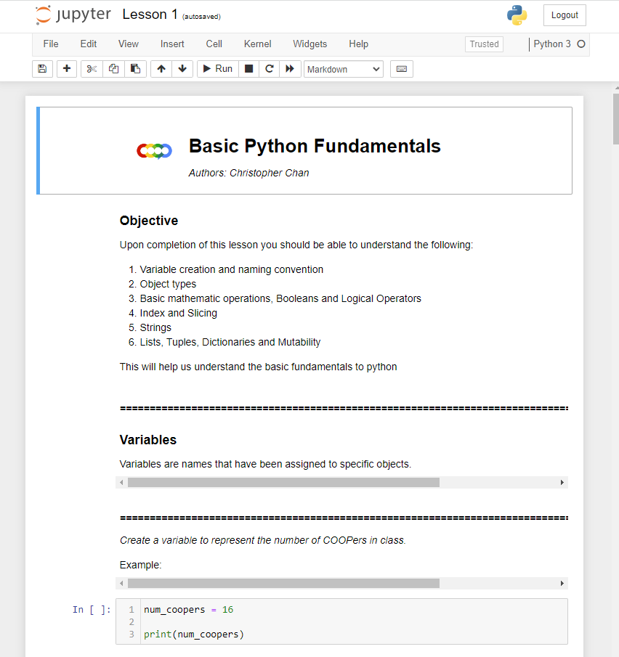
View the Notebook
This is what you should see when you have successfully opened the Python notebook.

Slide 11
Setting up Jupyter Notebook in the Cloud
Go to the cloud trial version here: https://jupyter.org/try-jupyter/lab/

Slide 12
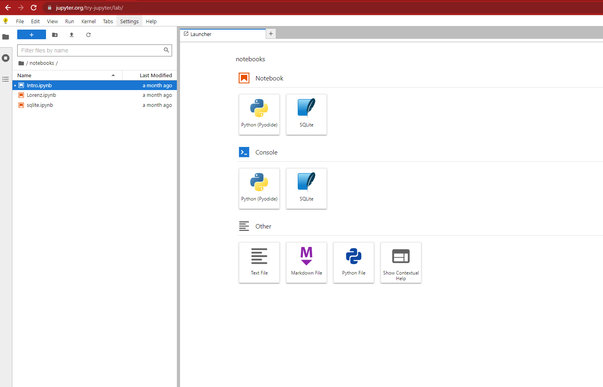
What you should see on the homepage

Slide 13
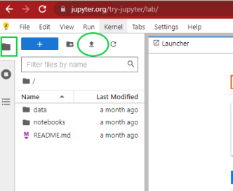
Upload the `Lesson 1` Notebook to the cloud

Slide 14
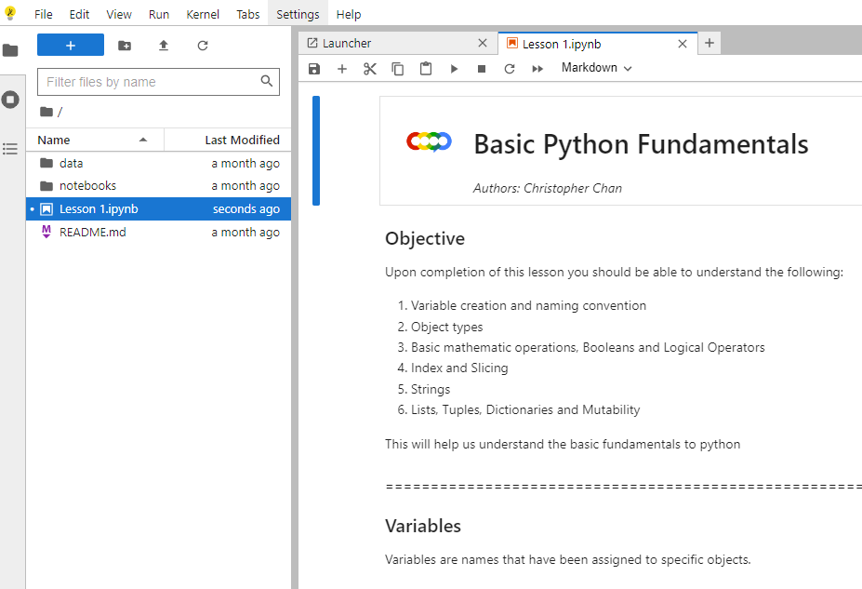
Double-click the uploaded file. You should see this:

Slide 15
Jupyter Notebook Basics

Slide 16
Cells and Code
Jupyter Notebooks are made up of cells, which are individual blocks that run either code or output formatted text.
Code cells are used to run Python code in isolation (meaning you can run code in a single cell without worrying about the code in others).
Text cells accept plain text and a format called Markup, as well as some HTML, in order to display text.
When you create a new cell, you can choose whether it should be used for code or text using the picker located in the menu

Slide 17
Using the Jupyter Notebook
Commonly Used Menu Buttons:
= Inserts a new cell below the currently selected one
= Removes the currently selected cell
= Executes code in the currently selected cell

Slide 18
Important: Jupyter Notebook Cloud Users!
Make sure to save and download the notebook that you worked on in class back to your computer after you’re finished. Otherwise, you might lose your work!

Slide 19

Congratulations!
You successfully opened your first Python file!
You must be tired from all that downloading, installing and navigating. Rest here weary traveler.

